Slide 1
Predicting Performance in Chess via Regression and Statistical Inference Methodologies
Investigating the Niemann Cheating Scandal

Slide 2
Background

Slide 3
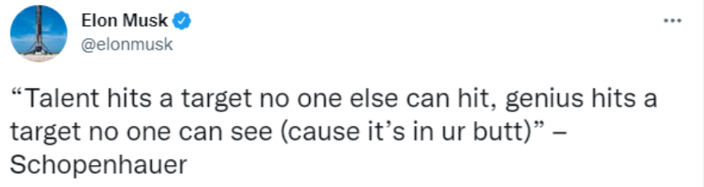
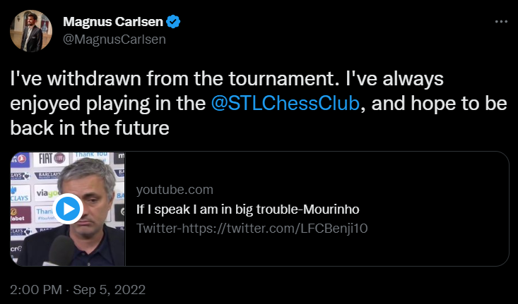


Slide 4
Data

Slide 5
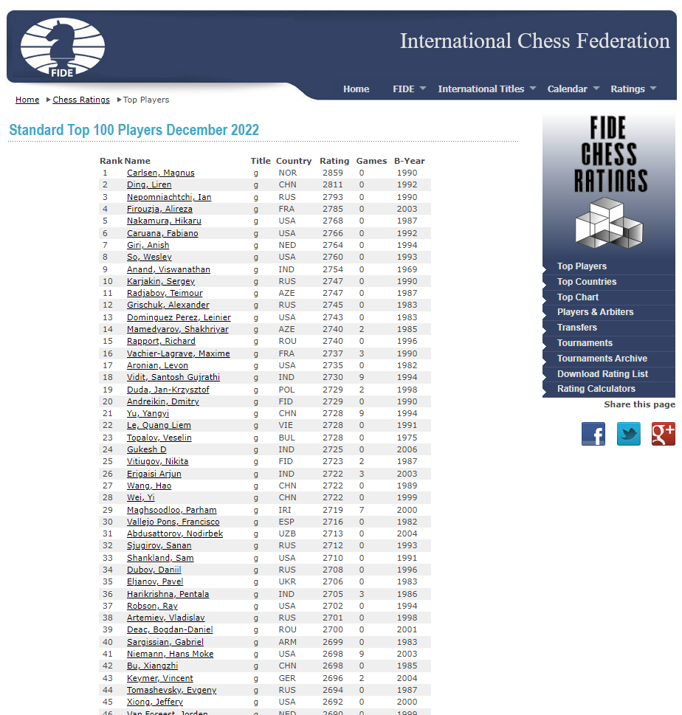
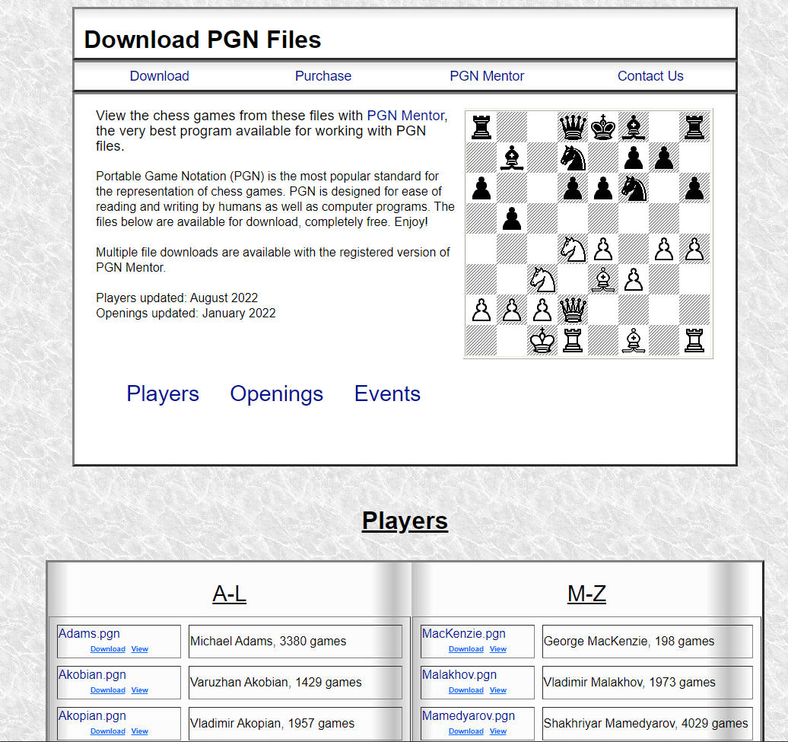
Data Gathering
Notes:
https://ratings.fide.com/top.phtml?list=men
https://www.pgnmentor.com/files.html#players

Slide 6
Resulting Dataset
Data
Contains information on over-the-board chess games played by 31 players
Key Variables
Elo - player’s Elo (ranking) before the game
Opponent Elo - the Elo of the opponent the player is playing against
Mean Centipawn Loss - number of hundredths of a pawn by which a player deviated from the most accurate move calculated by a computer averaged over all moves in the game
Standard Deviation in Centipawn Loss - standard deviation in the number of hundredths of a pawn by which a player deviated from the most accurate move calculated by a computer for all moves in the game

Slide 7
EDA

Slide 8
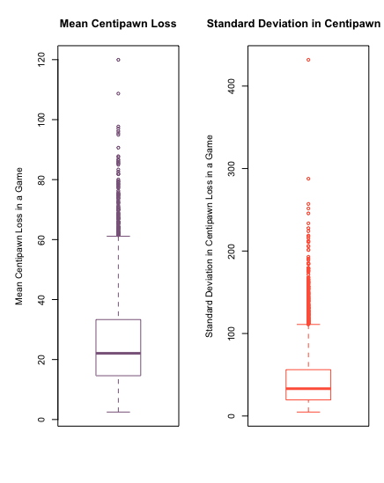
Exploring Centipawn Loss
Mean Centipawn Loss ranges from 2 CP to 119 CP
Centered around CP of 14 to 33
Standard Deviation in Centipawn Loss ranges from 4.77 CP to 431.85 CP
Centered around CP of 19.52 to 56.15

Slide 9
01
Question 1

Slide 10
What are the best predictors for how well and consistently a chess player performs?

Slide 11
Linear Regression w/ Outliers
Normalizing response variables by applying a natural log transformation:
Mean CP = ln(Mean CP)
SD CP = ln(Std CP)
With the OLS step forward regression method (provided by the olsrr library), we can select the subset of variables to create the best linear regression models predicting Mean CP and SD CP from the following full models:
MeanCP_{i} = β₀ + β₁∙StdCP_{i} + β₂∙Elo_{i} + β₃∙OppElo_{i} + β₄∙Age OR Time_{i} + ε_{i}
where ε_{i} ∈ N(0, σ²) iid
StdCP_{i} = β₀ + β₁∙MeanCP_{i} + β₂∙Elo_{i} + β₃∙OppElo_{i} + β₄∙Age OR Time_{i} + ε_{i}
where ε_{i} ∈ N(0, σ²) iid

Slide 12
Linear Regression w/ Outliers
Optimal regression equation with step forward variable selection (best model chosen based on R², Predicted R², Adjusted R², AIC, Mallow’s Cp):
MeanCP = 0.996 + 0.745∙StdCP - 0.0002∙Elo
- 3.7∙10⁻⁵∙OppElo
Adjusted-R² = 0.8562
F-statistic p-value < 2.2 ∙10⁻¹⁶
t-value=9.247
p < 2 ∙10⁻¹⁶ ***
t-value=-3.514
p = 0.000447 **
NOT SIGNIFICANT
INTERPRETATION:
On average, given identical player Elos, with every 1% increase in Std CP, Mean CP increases by (1.01^{0.745} - 1) * 100, or 0.744%, and on average, given identical Std CPs, with every point increase in player Elo, Mean CP increases by (e^{-0.0002} - 1) * 100, or -0.016%.

Slide 13
Linear Regression w/o Outliers
Repeating the same model selection process after removing Mean CP and Std CP outliers from the dataset:
MeanCP = 0.97 + 0.74∙StdCP - 1.59∙10⁻⁴∙Elo
- 2.35∙10⁻⁵∙OppElo
Adjusted-R² = 0.8568
F-statistic p-value < 2.2 ∙10⁻¹⁶
t-value = 156.523
p < 2 ∙10⁻¹⁶ ***
t-value = -3.503
p = 0.00046 ***
NOT SIGNIFICANT
INTERPRETATION:
On average, given identical player Elos, with every 1% increase in Std CP, Mean CP increases by (1.01^{0.74} - 1) * 100, or 0.742%, and on average, given identical Std CPs, with every 1 point increase in player Elo, Mean CP increases by (e^{-0.000159} - 1) * 100, or -0.016%.

Slide 14
Linear Regression w/ Outliers
Optimal regression equation with step forward variable selection (best model chosen based on R², Predicted R², Adjusted R², AIC, Mallow’s Cp):
StdCP = -0.42 + 1.14∙MeanCP - 1.20∙10⁻⁴∙Elo
- 3.27∙10⁻⁵∙OppElo
Adjusted-R² = 0.8564
F-statistic p-value < 2.2 ∙10⁻¹⁶
t-value = 156.622
p < 2 ∙10⁻¹⁶ ***
t-value = 2.175
p = 0.0297 *
NOT SIGNIFICANT
INTERPRETATION:
On average, given identical player Elos, with every 1% increase in Mean CP, Std CP increases by (1.01^{1.14} - 1) * 100, or 1.141%, and on average, given identical Mean CPs, with every 1 point increase in player Elo, Std CP increases by (e^{-0.0002} - 1) * 100, or 0.012%.

Slide 15
Linear Regression w/o Outliers
Repeating the same model selection process after removing Mean CP and Std CP outliers from the dataset:
StdCP = -0.404 + 1.146∙MeanCP
- 1.03∙10⁻⁴∙Elo - 3.85∙10⁻⁵∙OppElo
Adjusted-R² = 0.8577
F-statistic p-value < 2.2 ∙10⁻¹⁶
t-value = 156.622
p < 2 ∙10⁻¹⁶ ***
NOT SIGNIFICANT
NOT SIGNIFICANT
INTERPRETATION:
On average, with every 1% increase in Mean CP, Std CP increases by (1.01^{1.146} - 1) * 100, or 1.147%.

Slide 16
02
Question 2

Slide 17
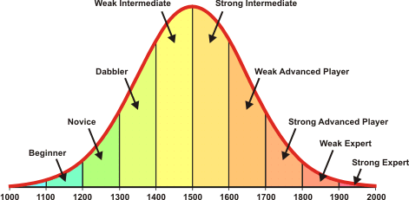
Methods for Question 2
Question: How does Niemann’s growth compare to other Grandmasters?
Methods
Elo as a measure of performance
Take Maximum Elo vs First Elo
Compare Niemann’s Elo Change to Other Players

Slide 18
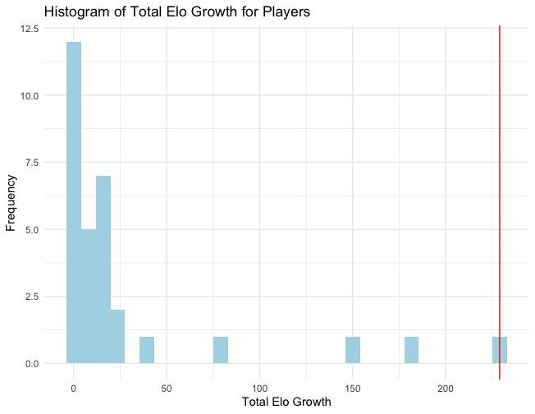
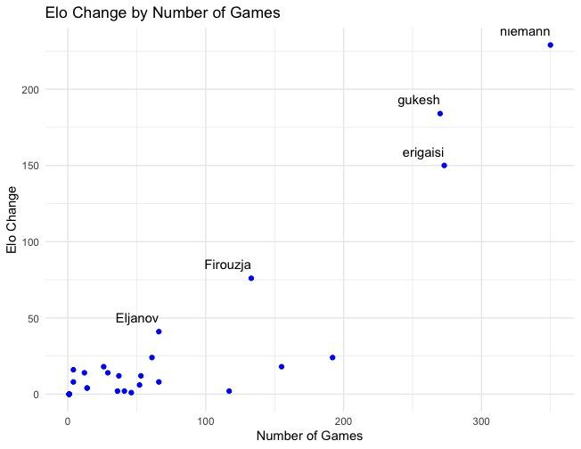
Visualization

Slide 19
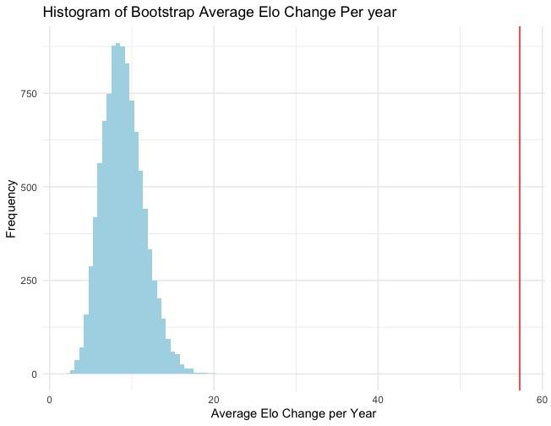
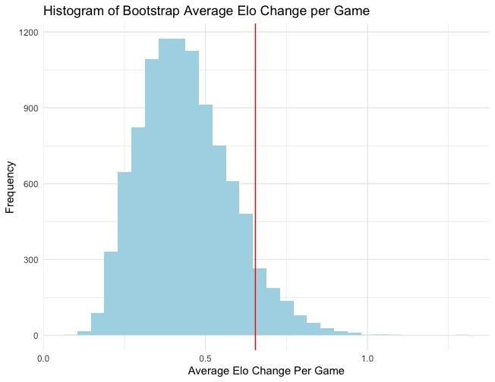
Results
95% Confidence Interval: [4.55 : 14.24]
95% Confidence Interval: [0.211 : 0.745]

Slide 20
03
Question 3
Notes:
Our third question was, how can we compare the performance of Carlsen to the other Grandmasters. To address that, we decided to do some t tests and some kruskal wallis tests

Slide 21
How do other GMs perform when compared to the current Champion Magnus Carlsen?
Mean Centipawn Loss T-Test
Bu Xiangzhi | Mean CP | 0.0003076189
Ding Liren | Mean CP | 0.0001958873
Ian Nepo | Mean CP | 0.0001694836
Wei Yi | Mean CP | 0.0159982436
Jennifer Yu | Mean CP | 0.0371047003
Std Centipawn Loss T-Test
Notes:
Our first t test compared mean centipawn loss. Out of 30 something players, carlsen’s mean centipawn loss was on average greater than only these five. It kind of makes sense intuitively, if you’re a good chess player, your mean centipawn loss won’t be greater than many others

Slide 22
How do other GMs perform when compared to the current Champion Magnus Carlsen?
Std Centipawn Loss T-Test
Dmitry Andreikin | Std CP | 2.524653e-02
Bu Xiangzhi | Std CP | 6.122359e-04
Ding Liren | Std CP | 3.393064e-05
Ian Nepo | Std CP | 5.687054e-06
Wei Yi | Std CP | 6.322617e-03
Jennifer Yu | Std CP | 7.677776e-03
Notes:
We did the same t test but focused on standard deviation centipawn loss. Especially after viewing the last slide, the results aren’t that surprising because five of these six names were just shown.

Slide 23
How do other GMs perform when compared to the current Champion Magnus Carlsen?
Kruskal-Wallis Test
Compared variance of players for both mean and std centipawn loss
Done with and without Carlsen
 | Test Statistic | P Value
Before | 187.25 | 2.2e-16
After | 182.02 | 2.2e-16
Notes:
Lastly, we did the kruskall wallis test

Slide 24
04
Question 4

Slide 25
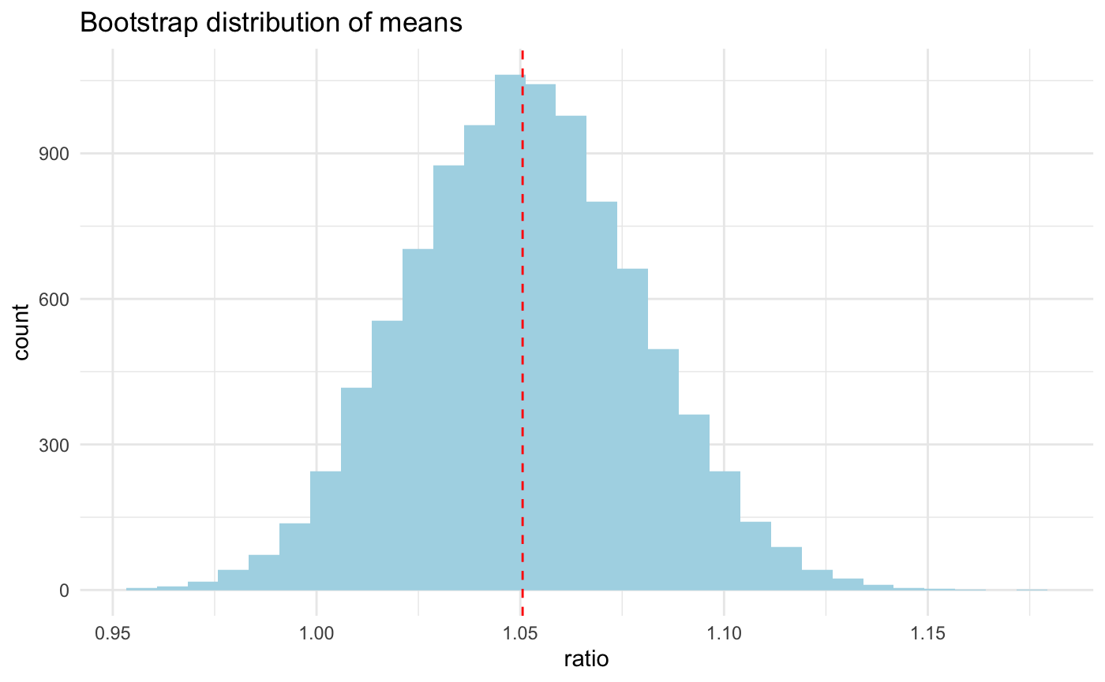
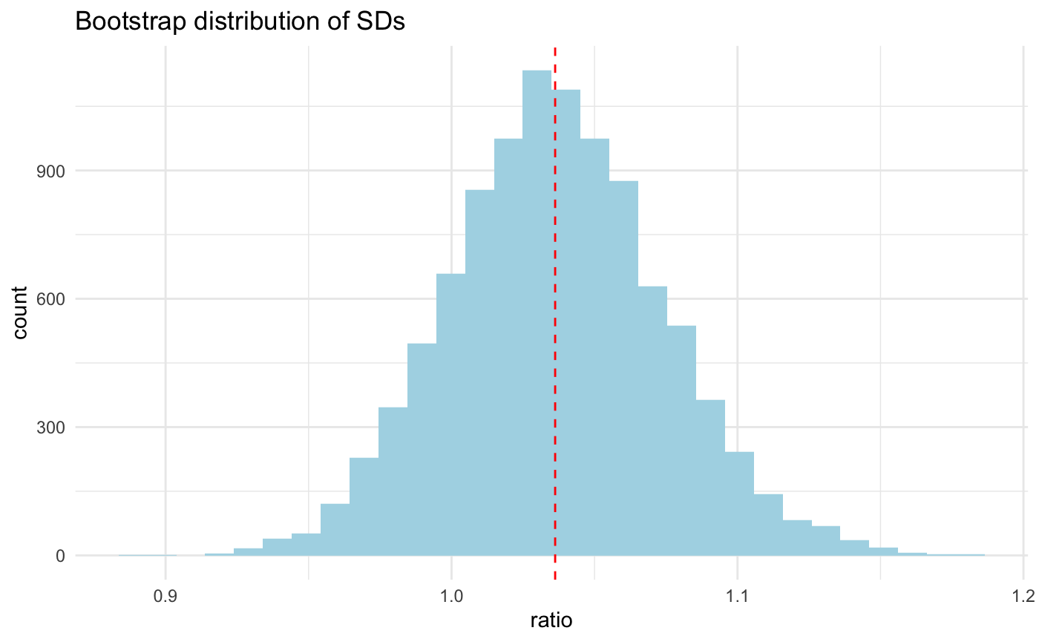
How do other GMs perform when compared to the rising chess prodigy Niemann?
Bootstrapping of Mean_cp
Bootstrapping of Std_cp
95% Confidence Interval: [1.00 : 1.11]
95% Confidence Interval: [0.97 : 1.11]

Slide 26
How do other GMs perform when compared to the rising chess prodigy Niemann?
_{T-test of Mean_cp}
_{T-test of Std_cp}
t=1.8045,
p-value=0.03593
95% confidence interval:
0.1115292 ~ Inf
t=0.96464,
p-value=0.1676
95% confidence interval:
-1.106044 ~ Inf
INTERPRETATION:
Niemann shows a statistically significant higher mean centipawn loss in comparison with other players, thus we reject the theory of Niemann cheating by using a computer helper.

Slide 27
Conclusions
What are the best predictors for how well and consistent a player performs?
As player’s accuracy tends to decrease as their consistency decreases (and vice versa).
A player’s accuracy tends to increase as their strength increases.
How does Niemann’s growth compare to other GMs?
Niemann has a statistically significant higher yearly ELO growth than the average player, but there is no evidence to suggest that his ELO growth per game is different from the average player. Mixed results that call for more research but no definitive proof of cheating.
How do other GMs perform when compared to the current World Champion Magnus Carlsen?
Out of the 31 grandmasters in our dataset, Magnus Carlsen performed with overall less accuracy and consistency than only 5-6 other grandmasters.
How do other GMs perform when compared to the rising chess prodigy Niemann?
Niemann performed less accurately than other GMs but played with the same consistency. Mixed results that call for more research but no definitive proof of cheating.

Slide 28
Discussion and Limitations
Consideration of dependencies within the data
Elo is inherently correlated w/ the player
Centipawn loss will be correlated w/ game time format
Centipawn calculations will differ based on the version of Stockfish used
Our dataset only considers over-the-board games and 31 professional players
When playing chess at grandmaster levels, there tends to be many outliers and influential points.
This could be because that at this level, the players tend to play variably (e.g. more risky / out-of-theory moves, time constraints).

Slide 29
Future Studies and Implications
There may be other analyses like Time Series Analysis that can provide better insight into whether, players like Niemann are cheating by considering performance over time.
Our dataset stops before the game when Niemann was accused of cheating against Carlsen. Future studies might try fitting the Mean CP and Std CP from that game into our regression models.

